Slide 1
Roman Contributions
Mr. Clutter
Librarian
Villegas Middle School

Slide 2
Roman Aqueduct
Ancient Rome had eleven major
aqueducts, built between 312 B.C.
and 226 A.D.the longest (Anio Novus)
was 59 miles long.

Slide 3
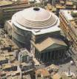
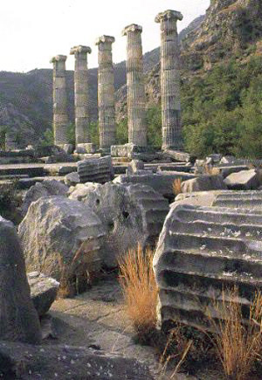
Roman Architect
Rome Pantheon - Dome
Round Columns
Temple of Fortuna Virilis
Coliseum – Arena

Slide 4
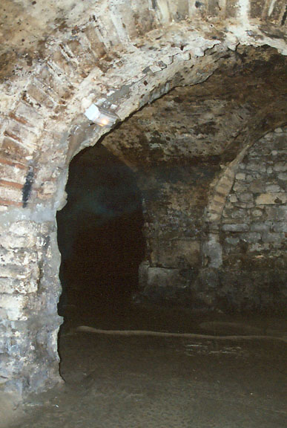
Roman Architect Part II
Vaults were Roman era shops
Arches – Served as a
Gateway

Slide 5
Roman Architect Part III
London building that
Contains Roman Arches
Traditonal Roman
Arch blue print
Keystone was the basis
for the building.

Slide 6
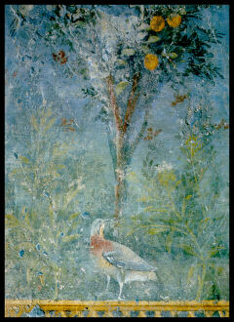
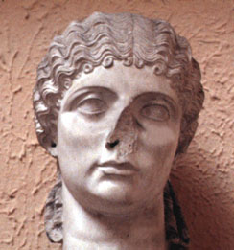
Roman Art
Roman Flasks {Glass}
Bird in the Garden - Fresco
Roman Mosaic
Roman Bust in marble

Slide 7
Roman Domes
The Pantheon dome was
142 feet long and 71 feet
high with no support
columns.

Slide 8
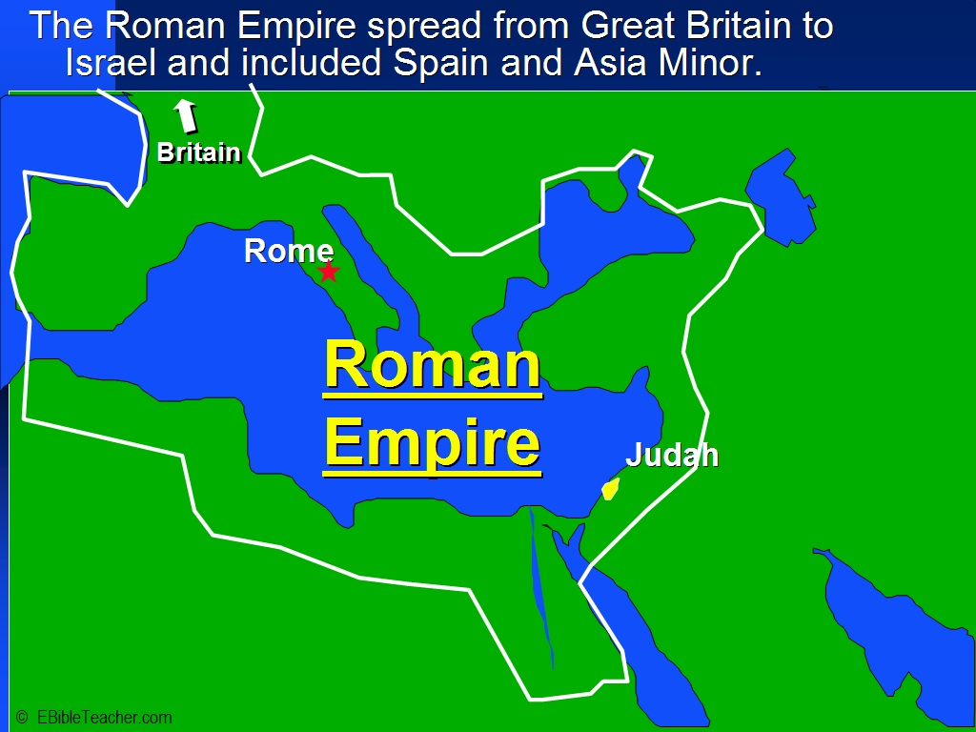
Roman Empire

Slide 9
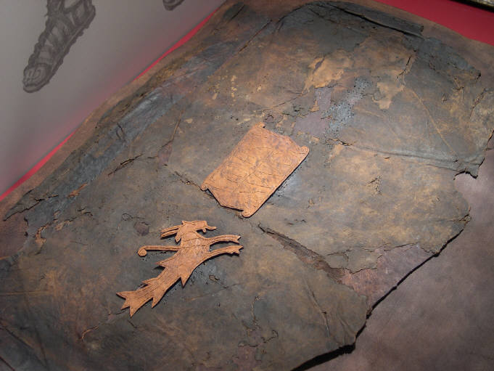
Roman Gladiators
Gladiator Helmet
Roman Shield

Slide 10
Roman Language: Latin
Roman Empire it was referred to as Latium.
Romance languages descend from Latin
Currently Latin is a dead language. That means it is not spoken by any country but yet it is taught in some schools.
It is responsible for our current use of Roman Numbers for notes I, II, III etc.
Also responsible for many proverbs.

Slide 11
Roman Literature
Oratory: Marcus Cicero greatest known – persuasion, teaching, dialogue, etc
Mythology: Rituals, priestly colleges, clusters of related gods
Historical myths interwoven with divine intervention
Philosophy: Cicero, Stoics virtues of wisdom, self control, courage. This was contrary to the Greeks “life of pleasure”

Slide 12
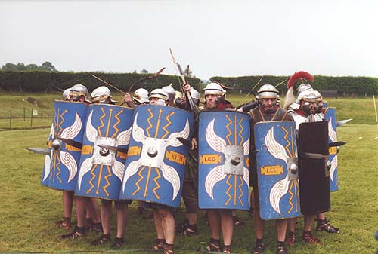
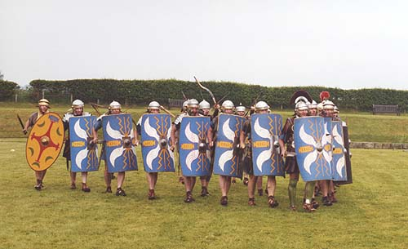
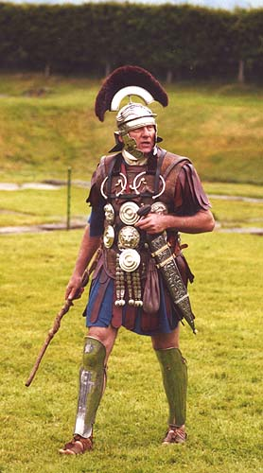
Roman Military
The Orb
The Wedge
Centurion

Slide 13
Roman Politics
Tribune – was someone who fought for the rights of the poor but it was not a popular position to hold.
Jurisprudence – the theory and practice of law. Lawyers get a J.D. degree
3 Branches of Government: The Consul {civil and military} The Senate {advisory} and the Assembly {members of the army}
Veto concept was introduced by the Romans.
Twelve Tables was the law carved into bronze and displayed in the City Center.
Patricians were eligible to elect representatives to serve in one of the 3 branches.

Slide 14
Roman Christianity
The origins and early spread of Christianity took place in the Roman Empire. It was based on the teachings of Jesus Christ. Spread during the PAX Romana. Despite persecution of the early Christians, Christianity became the official religion of the Roman Empire.

Slide 15
Rights of women
Women, or more correctly, girls, were usually married by the time they were twelve years old
the law required that all women, young and old, be under the care of a "guardian".
women were not restricted from owning property and wealth. If it benefited her husband.

Slide 16
This powerpoint was kindly donated to www.worldofteaching.com
http://www.worldofteaching.com is home to over a thousand powerpoints submitted by teachers. This is a completely free site and requires no registration. Please visit and I hope it will help in your teaching.

